Slide 1
Mathematics for computing – 22MAT122
Elements Of Computing-II – 22MAT113
Skin Cancer Detection Using SVM with HOG Features and SMOTE Oversampling
TEAM MEMBERS:
1.HIMABALA - CB.SC.U4AIE24028
2.NIKHIL - CB.SC.U4AIE24053
3.SANDEEP - CB.SC.U4AIE24047
4.CHAITHANYA - CB.SC.U4AIE24040

Slide 2
INDEX 1.INTRODUCTION 2.OBJECTIVE 3.LITERATURE REVIEW 4.DATASET-HAM10000 5.METHODOLOGY 6.CONFUSION MATRIX 7.EVALUTION METRICS 8.LIVE PREDICTION USING WEBCAM 9. RESULTS AND ANALYSIS 10.DISCUSSION 11.CONCLUSION 12.FUTURE WORK

Slide 3
INTRODUCTION
Our project focuses on developing a system to detect skin cancer using machine learning techniques and image processing methods.
We used the HAM10000 dataset, which includes thousands of real dermoscopic images of different skin lesions.
To extract useful information from these images, we applied HOG (Histogram of Oriented Gradients) feature extraction.
The dataset is imbalanced so, we used SMOTE (Synthetic Minority Over-sampling Technique) to balance it and evaluated the system using accuracy, precision, recall, and F1-score to understand how well the model performed.

Slide 4
OBJECTIVE
Develop a skin cancer detection system using Support Vector Machine (SVM) classification.
Extract key features from images using Histogram of Oriented Gradients (HOG).
Address class imbalance issues using oversampling techniques for minority classes.
Implement real-time prediction capability using webcam image input.

Slide 5
LITERATURE REVIEW
Model / Approach | Paper / Study | Dataset & Setup | Key Results | Remarks
SVM with HOG Features | G. Neela Krishna Babu & V. Joseph Peter, "Skin Cancer Detection Using Support Vector Machine with Histogram of Oriented Gradients Features" | ISIC 2018 dataset; images converted to grayscale, preprocessed with median filter; HOG features extracted and classified using SVM with RBF kernel | Accuracy: 76%, Specificity: 85%, Precision: 84%, Recall: 76%, F1-score: 75% | Demonstrated the effectiveness of combining HOG features with SVM for skin cancer classification
Optimized CNN Architecture | "Enhanced skin cancer diagnosis using optimized CNN architecture and transfer learning" | HAM10000 dataset; applied data augmentation and transfer learning techniques | Achieved high diagnostic accuracy (specific metrics not specified) | Showcased the potential of CNNs with transfer learning in improving skin lesion classification accuracy
DenseNet169 CNN Model | "Transforming Skin Cancer Diagnosis: A Deep Learning Approach with the HAM10000 Dataset" | HAM10000 dataset; trained and tested 11 CNN architectures, including DenseNet169 | DenseNet169 achieved Accuracy: 92.25%, Recall: 93.59%, F1-score: 93.27% | DenseNet169 achieved Accuracy: 92.25%, Recall: 93.59%, F1-score: 93.27%

Slide 6
Dataset – HAM10000
We used the HAM10000 public dataset, which includes 10,000+ dermatoscopic images.
Lesion Type | Abbreviation | Cancerous?
Melanoma | MEL | Yes
Melanocytic Nevi | NV | No
Basal Cell Carcinoma | BCC | Yes
Actinic Keratoses | AKIEC | Yes
Benign Keratosis | BKL | No
Dermatofibroma | DF | No
Vascular Lesions | VASC | No

Slide 7
METHODOLOGY
Data Collection :
We used the HAM10000 public dataset, which contains thousands of dermatoscopic images across 7 types of skin lesions.
Ground truth labels were loaded from an Excel/CSV file, and corresponding images were selected.
Preprocessing & Feature Extraction :
Images were converted to grayscale and resized to a uniform size (64x64 pixels)
We extracted HOG (Histogram of Oriented Gradients) features from each image.
These capture the edge and texture information, which is crucial for distinguishing skin lesions.

Slide 8
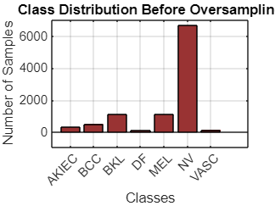
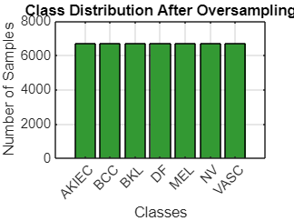
Dataset Balancing (Oversampling) :
The dataset was imbalanced, with some skin cancer types underrepresented like they have less number of images compared to the other type cancers.
We applied a simple oversampling technique:
Minority class samples were randomly duplicated to match the majority class count.

Slide 9
SVM Training and Saving :
We used an 80-20 train-test split on the balanced dataset:
80% of the data was used to train the SVM model.
20% was reserved for testing and evaluating the model’s performance.
An SVM classifier is trained on 80% of the balanced data. The trained model is saved to avoid retraining every time.
The remaining 20% is used for testing, and a styled confusion matrix (with row and column percentages) is plotted to evaluate model accuracy.

Slide 10
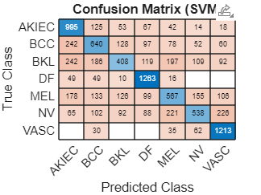
Confusion Matrix
Each row represents the actual class, and each column shows the predicted class, normalized to show percentage-based summaries.
The matrix highlights true positives using a green color .And the diagonal cells show how many images were correctly classified.
Off-diagonal cells represent misclassified cases that need attention. Overall, the matrix is a useful diagnostic tool for model evaluation.

Slide 11
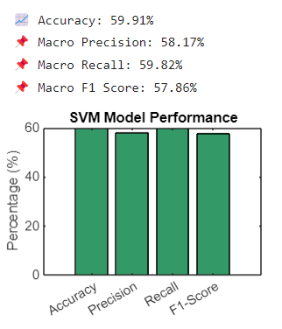
Evaluation Metrics
We also calculated precision, recall, and F1-score for each class using a loop and displayed the class-wise values.
These values help analyze the classifier's strengths and weaknesses in detail. Such analysis is critical in medical applications where misclassification is serious. We displayed all metrics numerically to support the visual matrix.

Slide 12
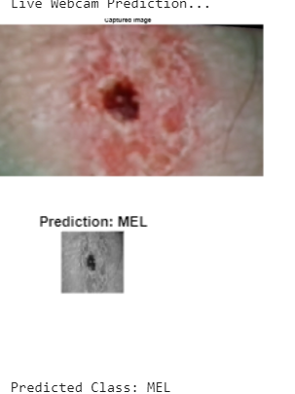
Live Prediction using Webcam
The live prediction feature captures a real-time image when we run the code and the image will be resized and pre-processed too match training image dimensions and then it will be converted into grayscale to extract HOG features.
After taking the image it will immediately gives which type of cancer it is and tells whether it is maligant or benign.

Slide 13
Results and Analysis
Model Accuracy and Performance: The SVM model achieved about 60.57% accuracy, correctly identifying most test samples. This shows us good learning performance, especially considering real-world variations in skin lesion images.
Precision, Recall, and F1-Score: The model reached a macro precision of 59.34%, recall of 60.76%, and F1-score of 58.56%, which means it balanced well across all cancer types, even with class imbalance.
Insights from Confusion Matrix: A green-themed confusion matrix showed how the model performed per class. It helped identify where misclassifications happened, giving clues to improve the system.
Webcam-Based Prediction: After training, the model successfully predicted skin cancer types from live webcam images. This shows its real-time use potential for skin screening applications.

Slide 14
Discussion
The model performed well despite being lightweight and fast. And HOG features were effective for texture-based skin analysis.
SMOTE helped improve recall and reduce class bias.
Some classes were more difficult to classify than others
SVM proved to be effective but not perfect — its performance can vary based on feature quality and data balance.
Lighting and image quality may have affected both dataset performance and webcam predictions.

Slide 15
Conclusion
Efficient Detection System Developed using SVM, HOG features and simple oversampling to handle class imbalance.
Balanced and Practical Model by applying simple oversampling and we can ensure real-world performance , even with unbalanced data like medical images.
Real-Time Usability with Webcam : The system not only predicts from test data but also works with live webcam input, showing it can be used for real-time screening and early detection support.

Slide 16
Future Work
We aim to use more advanced oversampling methods like SMOTE to further improve performance and avoid overfitting.
Using deep learning-based models like CNN can further enhance results and automate feature extraction.
We also plan to build a user-friendly mobile app or GUI for easier access by doctors or patients in real-world use.

Slide 17
THANK YOU

